Slide 1
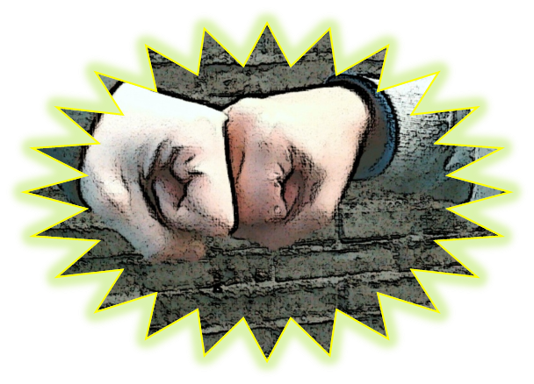
Cartoon Project about Bullying at School in English for 7th graders (age 13)
Janne Männikkö
Metsokangas Comprehensive School
Finland
http://www.ouka.fi/oulu/metsokankaan-koulu
Part of Finnish iTEC and Ki-Va –school projects
Notes:
Hi!
My name is Janne Männikkö from Metsokangas Comprehensive School in Finland. My learning activity is a cartoon project about bullying at school in English for 7th graders.

Slide 2
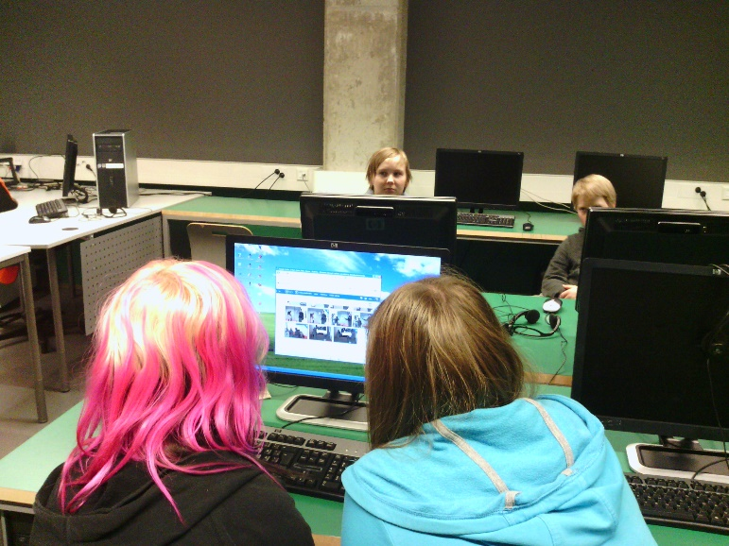
The objectives of this learning activity
to get students to discuss bullying and get them understand the seriousness of it and the possible outcomes of bullying and the possible solutions in these situations (part of KiVa-school project in Finland (Ki-Va = Against Bullying)).
learn English vocabulary concerning the subject (English lessons).
learn to plan collaboratively.
learn to draw a storyboard (Art lessons).
use tablets for photographing (ICT).
use Onedrive as a platform and collaborative tool (ICT).
import and export photos (Onedrive/Word).
learn to reflect upon their work by using WeLearn –program and Onedrive.
Notes:
The main objectives of this project were to get the students to discuss about solutions for bullying, learn vocabulary, collaborating, reflecting, the basic use of tablets and Onedrive and to learn how to import/export files to and from Onedrive and Word.

Slide 3
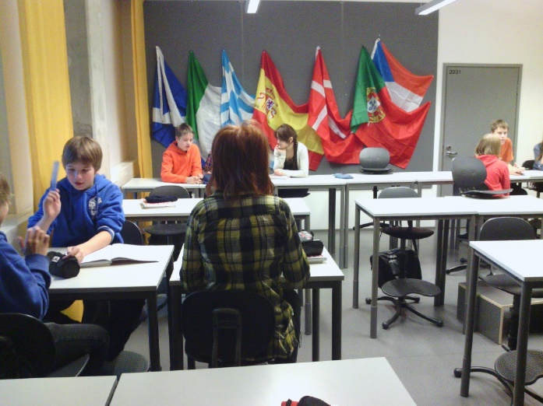
Project description
Lessons 1 – 2
  The projects goals were presented to the students.
  The students were given written instructions and an assessment form which were used throughout the project (they were also uploaded to Onedrive and shared to students so that they could be revised).
  The students started by discussing bullying and creating a story about bullying based on their possible own experiences collaboratively in group discussions.
  Reflection to Onedrive after each lesson by shooting it with a tablet and uploading it to Onedrive so that in could be revised if needed.
    What was done?
    Possible problems
    Possible solutions
    What next?
    Possible problems (if any) and solutions
Notes:
First the student were given the background information, goals and instructions for the project. They were also given the assesment form they used throughout the project. All this was also uploaded to a shared Onedrive folder.
The next stage for the students was to discuss about bullying in general on the base of their own knowledge and experiences.
After each lesson the students were required to record a reflection upload them to Onedrive so that they could be revised if needed.

Slide 4
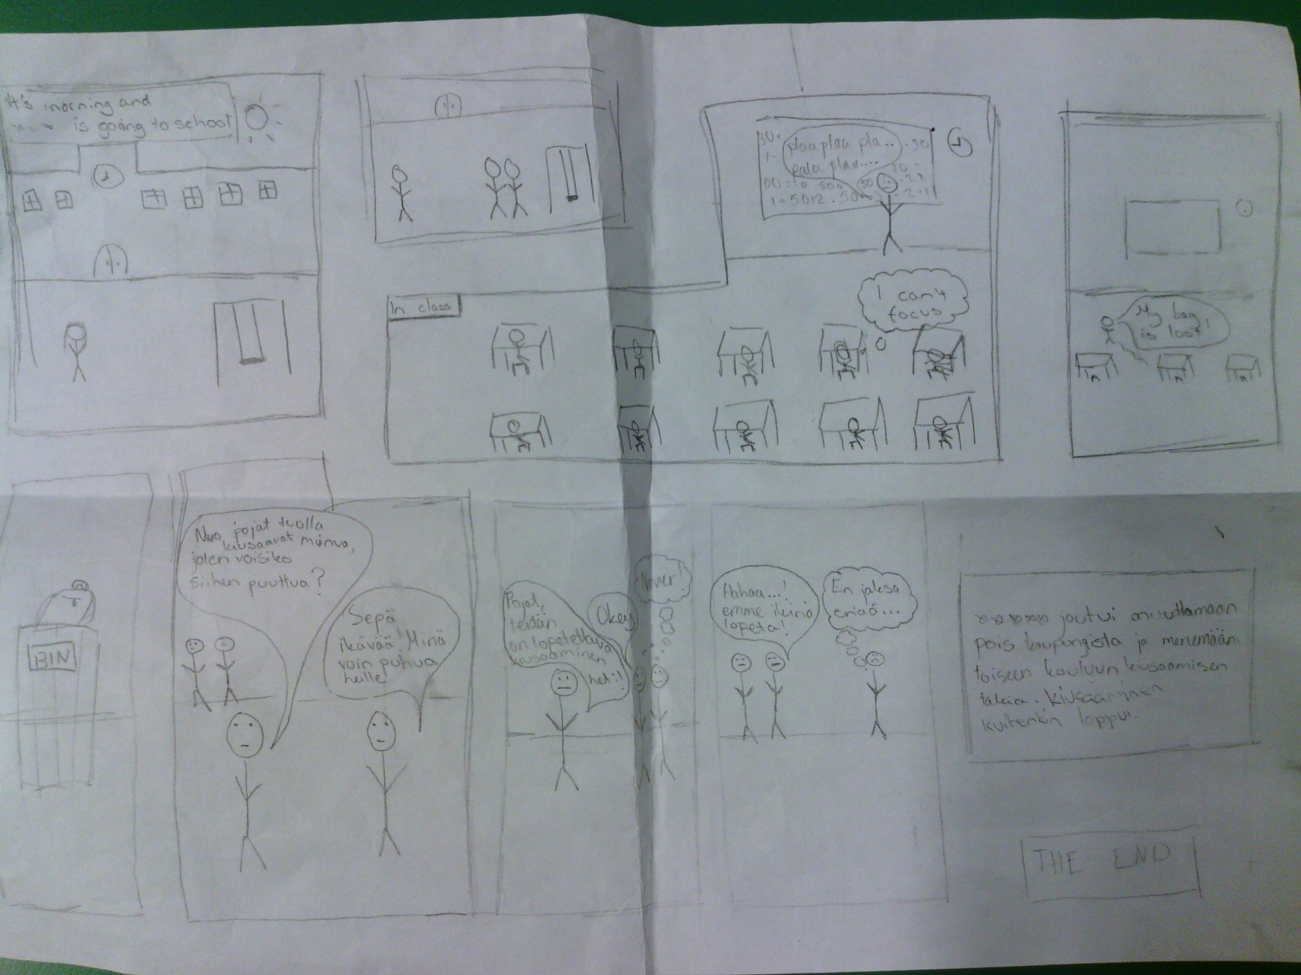
Lesson 3 - 4
  The students made a drawn storyboard of their story about bullying during arts lesson.
Notes:
After they had created a story on the earlier lesson, they drew a storyboard of it during the arts class.

Slide 5
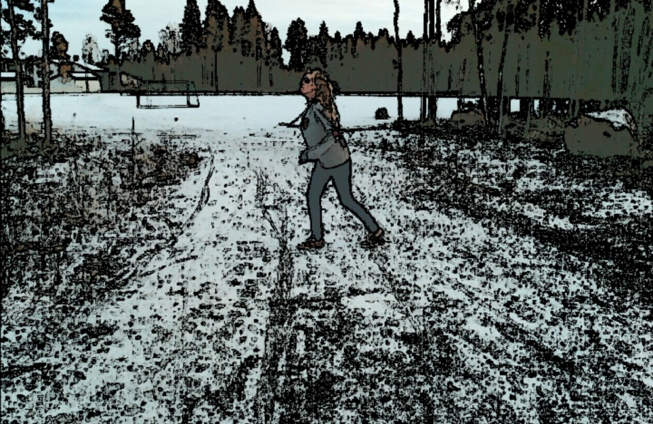
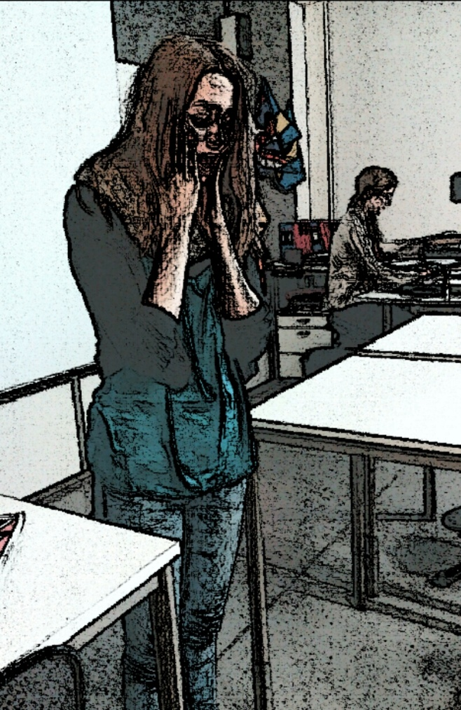
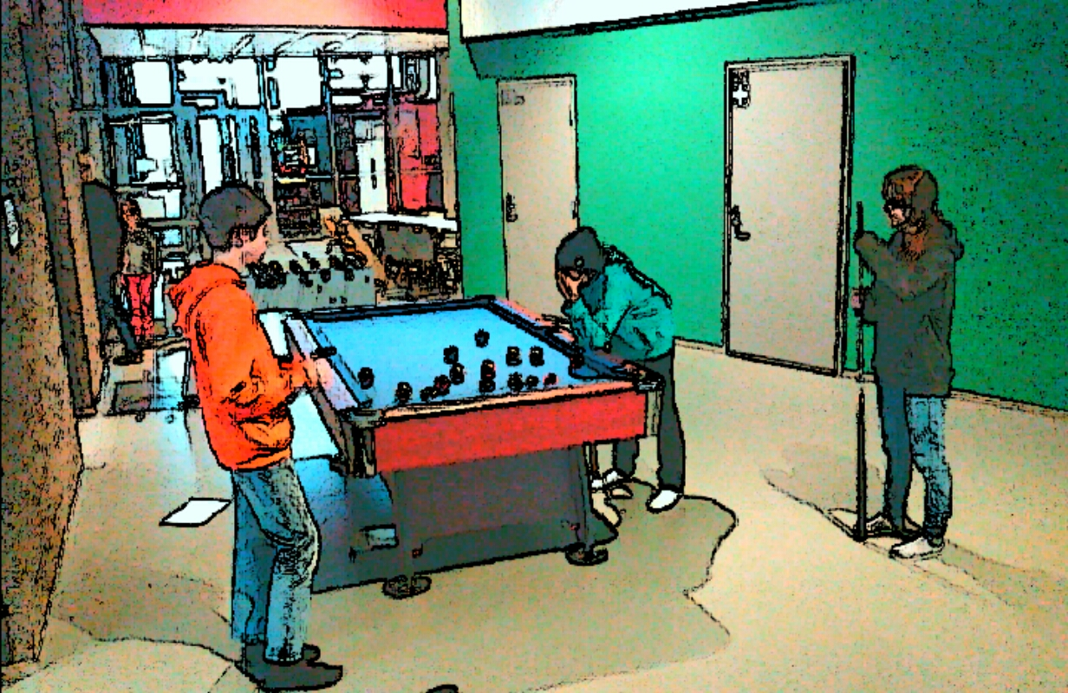
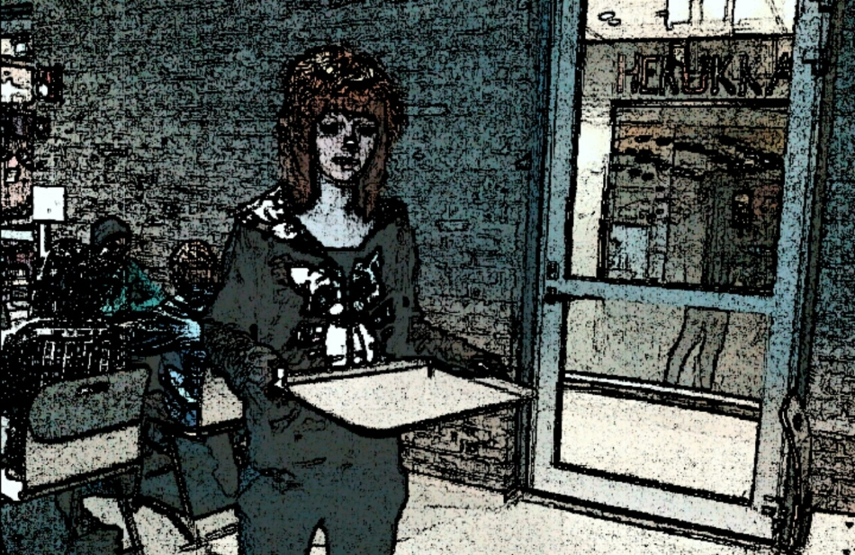
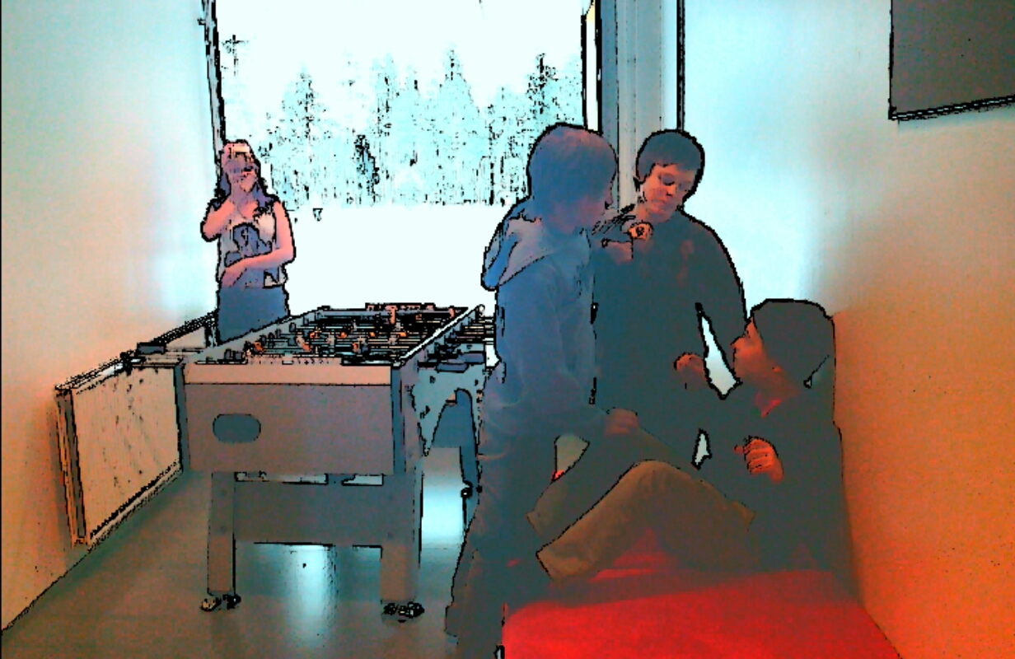
Lesson 5
  The students selected the "actors" for the cartoon. This because the cartoon was created by photographing the frames using a special program called Cartoon Camera (makes cartoonlike pictures of photos). At this point students were given the tablets and the photographing starts.
Notes:
On the next step the students acted out the bullying situations and photographed them using tablets.

Slide 6

Lesson 6
  The photos were then exported to Onedrive from which they were again imported to Word on a desktop computer for editing.
Notes:
After photographing the photos were uploaded to Onedrive for editing.

Slide 7
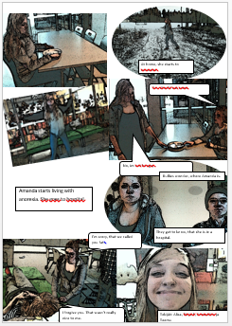
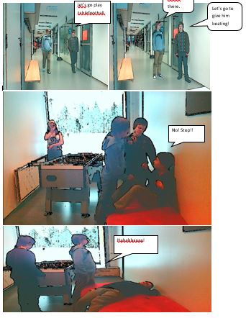
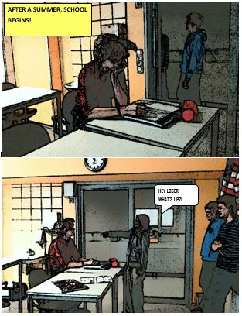
Lessons 7 - 8
  At this point the the pictures were arranged in a cartoonlike order and captioned using Microsoft Word.
Notes:
Then the pictures were arranged into a cartoon like order and captioned using Word.

Slide 8
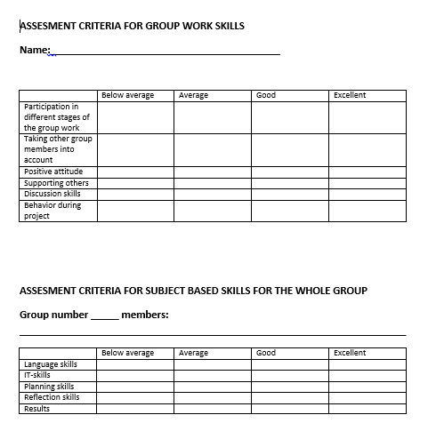
Lessons 9 - 10
  The presentation. After the cartoon was finished they were presented to the class using a projector and discussed from both the point of view of bullying and as a project.
  After discussions the projects were evaluated by the teacher and the peer students using a beforehand given assesmentform.
Notes:
When the cartoon was finished they were presented to the class and they were discussed. Students discussed about the bullying shown in the cartoons and tried to find possible solutions for the presented situations. The students also evaluated the cartoons using the assesment form given beforehand.
The projects were of course evaluated by the teacher too.

Slide 9
The project’s outcomes
During this project the students discussed bullying in a constructive way. They pondered upon different kinds of situations and tried to find solutions for them. The students learned a great deal about how serious bullying can be and why it should not be tolerated.
The students were clearly more able to place themselves into the bullied person’s role after the project.
Notes:
This project got the students to discuss about bullying in more relaxed way in groups. During these discussions they realized that there are different kinds of bullying and they tried to find ways to react to it and deal with it.

Slide 10
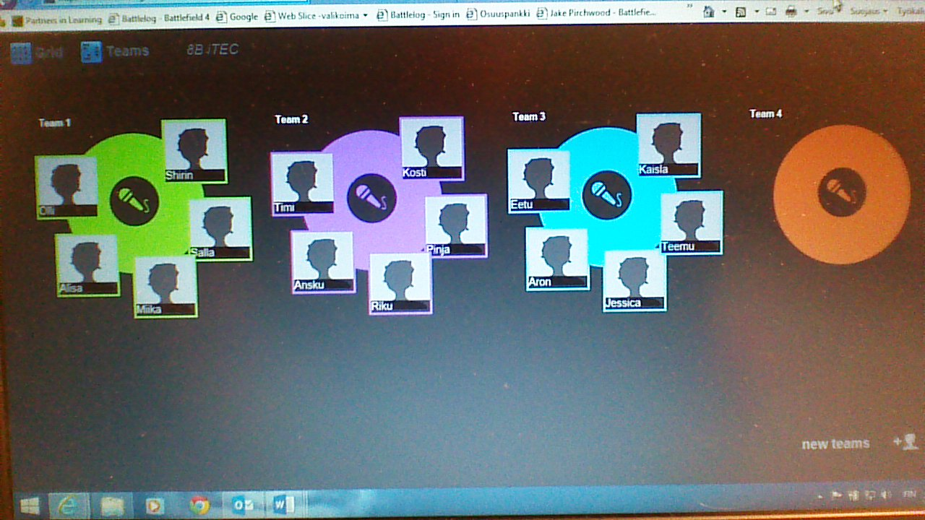
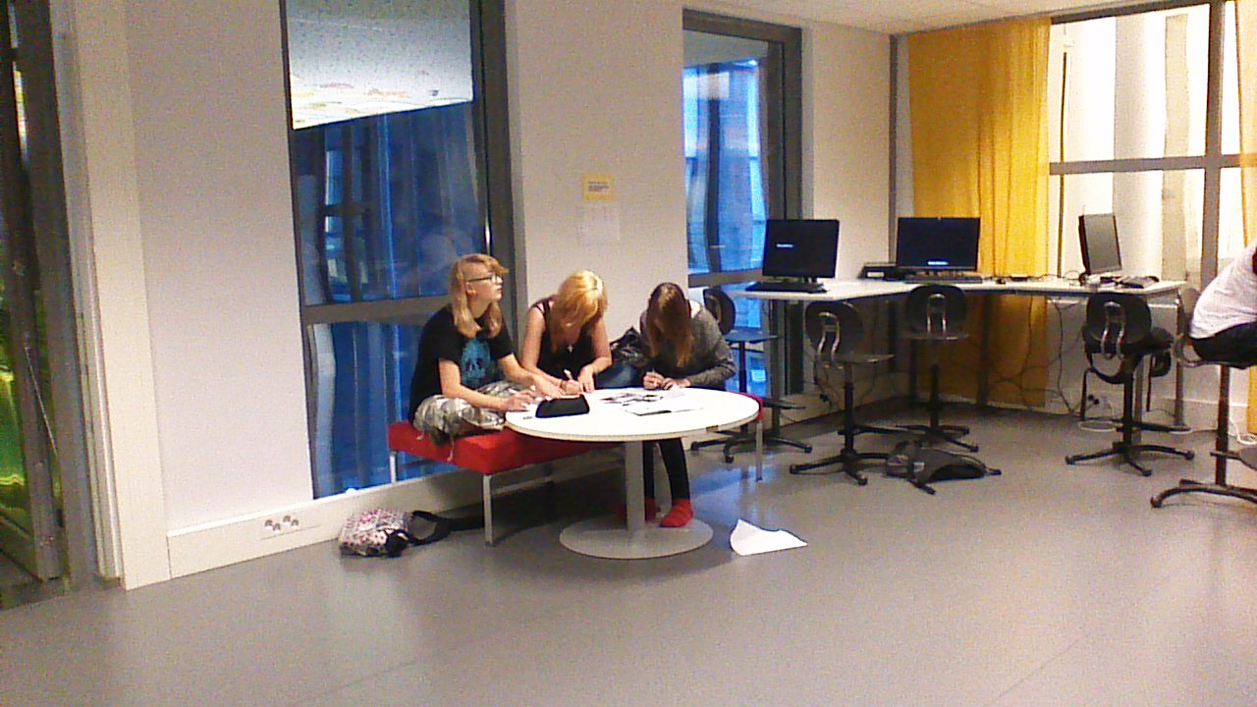
The proper use of Onedrive as a platform and as a collaborative tool was learned during this project.
Students learned to use tablets and import and export files.
The use of reflection tools was learned.
Notes:
As a secondary outcome the students learned how to use collaborative tools and collaborative work methods in general. They also learned how to use Onedrive properly.

Slide 11


Throughout the project the students learned how to collaborate in order to get the required product (cartoon) finished. The students had their own groups in Onedrive through which they could communicate outside school and do their cartoon when not at school.
Because of the nature of the project the students were allowed to move around the school premises and outside to take the pictures for the cartoons. This taught them resposibility of their own actions.
Notes:
Because of the nature of the activity the students also learned to collaborate in order to get a product finished. Everybody had to take part in the project otherwise the cartoon wouldn’t have finished and everybody had a role in doing it.

